Slide 1
Lecture 13: Indexing and Hashing

Slide 2
Indexes
An index on a file speeds up selections on the search key fields for the index.
Any subset of the fields of a relation can be the search key for an index on the relation.
Search key is not the same as key (minimal set of fields that uniquely identify a record in a relation).
An index contains a collection of data entries, and supports efficient retrieval of all data entries with a given key value k.
Notes:
7

Slide 3

Basic Concepts
Indexing mechanisms are used to speed up access to desired data.
E.g., author catalog in library
E.g. Index at end of DBMS course text book
Search Key - attribute to set of attributes used to look up records in a file.
An index file consists of records (called index entries) of the form
Index files are typically much smaller than the original file
search-key
pointer

Slide 4

Cost of Queries
How to answer the following queries efficiently:
Query 1: Find all instructors in Physics Department.
Select * from instructor
where dept_name = 'Physics';
Query 2: Find salary of instructor with ID 10101
Select * from instructor
where ID = ‘22222’;
The most expensive operation is disk I/O
Goal: answer queries with the minimum possible number of I/O operations.

Slide 5
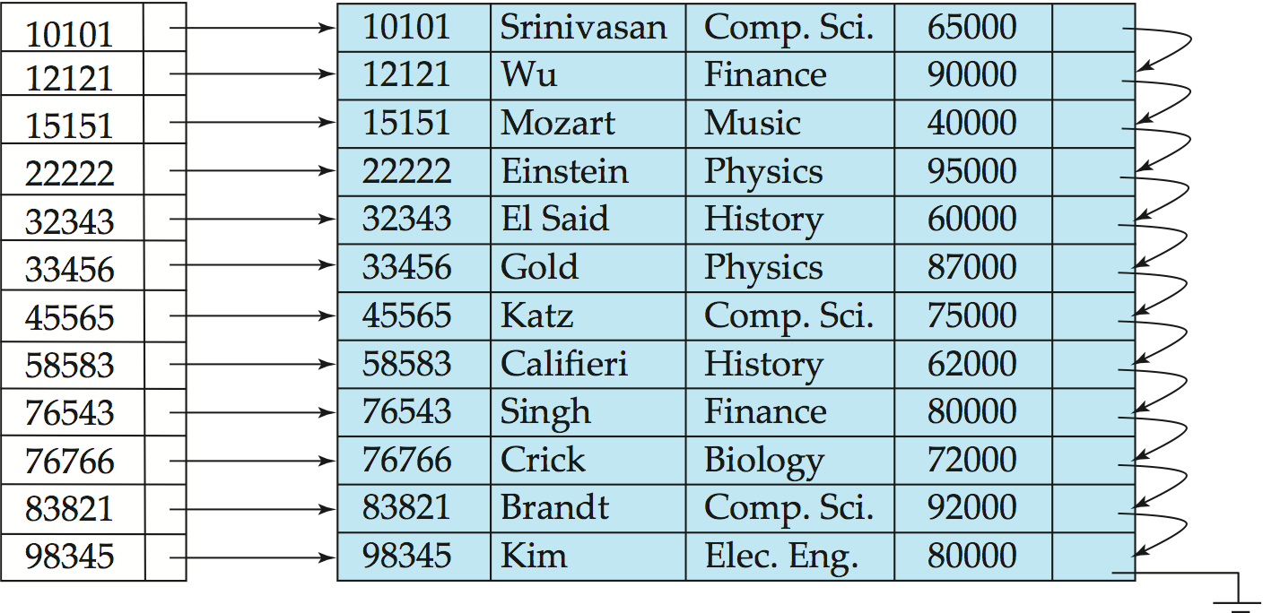

Index Example 1
Index on ID attribute of instructor relation
Query 1 can be answered by scanning the whole file.
Query 2 can be answered by location ID 22222 in the index and then accessing the record directly

Slide 6
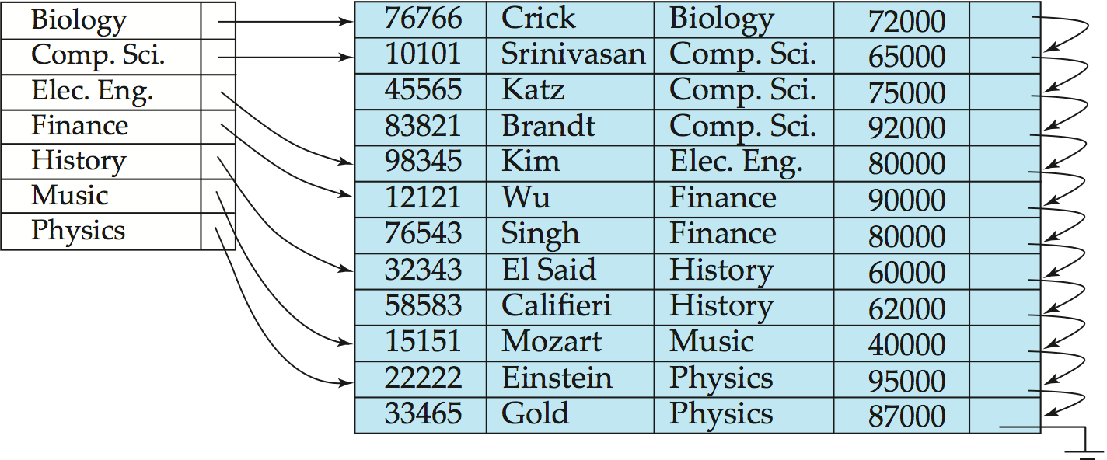

Index Example 2
Index on dept_name with instructor file sorted on dept_name
Query 1 can be answered by looking up Physics department in index and then accessing only one page of the file
Query 2 can be answered by scanning the whole file

Slide 7
Choice of Indexes
What indexes should we create?
Which relations should have indexes?
What field(s) should be the search key?
Should we build several indexes?
For each index, what kind of an index should it be?
Clustered? Hash/B+ tree?
Notes:
12

Slide 8
Index Evaluation Metrics
Two basic kinds of indices:
Ordered indices: search keys are stored in sorted order
Hash indices: search keys are distributed uniformly across “buckets” using a “hash function”.
Other factors to consider:
Access types supported efficiently. E.g.,
Equality search: find a record with a specified value
Range search: find all records falling in a specified range of values.
Access time
Insertion time
Deletion time
Space overhead

Slide 9
Ordered Indices
In an ordered index, index entries are stored sorted on the search key value. E.g., author catalog in library.
Primary index: in a sequentially ordered file, the index whose search key specifies the sequential order of the file.
Also called clustering index
The search key of a primary index is usually but not necessarily the primary key.
Secondary index: an index whose search key specifies an order different from the sequential order of the file. Also called non-clustering index.
Index-sequential file: ordered sequential file with a primary index.

Slide 10
Index classifications
Dense vs. Sparse index
Clustered (primary) index vs. Unclustered (secondary)
Ordered index vs. Hash index

Slide 11
Dense vs. Sparse Index
Dense index — Index record appears for every search-key value in the file. E.g. Primary Key
Sparse Index: contains index records for only some search-key values.
Applicable when records are sequentially ordered on search-key E.g. Salary in Sorted order

Slide 12

Dense Index Files
Dense index — Index record appears for every search-key value in the file.
E.g. index on ID attribute of instructor relation

Slide 13

Dense Index Files (Cont.)
Dense index on dept_name, with instructor file sorted on dept_name

Slide 14
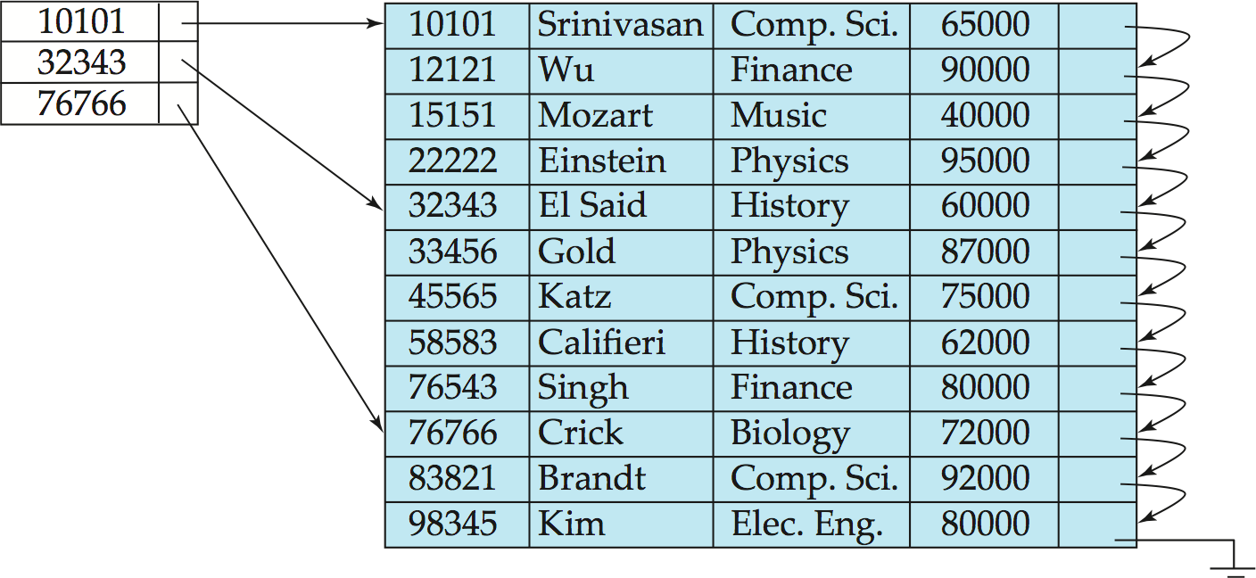

Sparse Index Files
Sparse Index: contains index records for only some search-key values.
Applicable when records are sequentially ordered on search-key
To locate a record with search-key value K we:
Find index record with largest search-key value < K (E.g. To find 22222, start at 10101)
Search file sequentially starting at the record to which the index record points

Slide 15
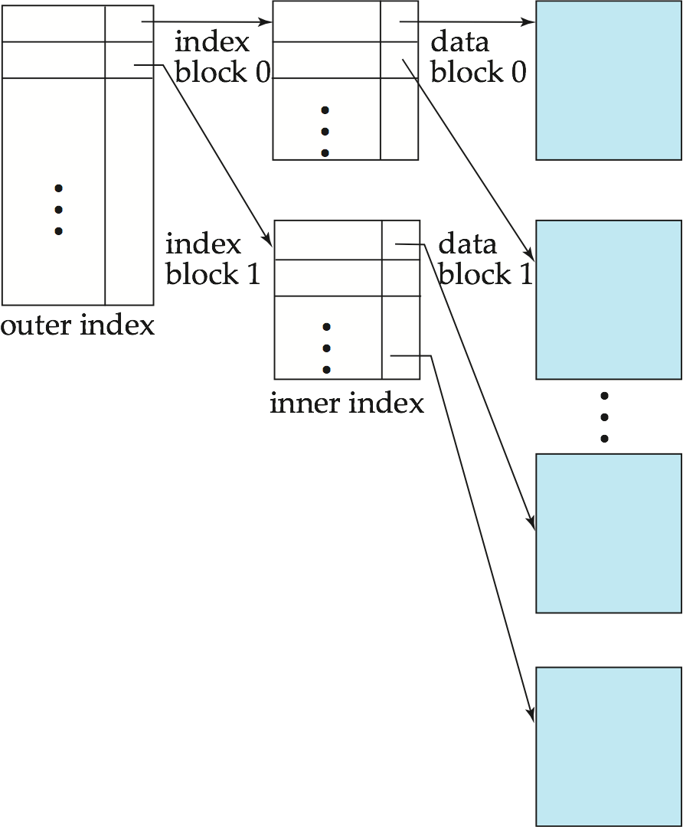
Dense vs. Sparse Index
A Sparse index uses less space and less maintenance overhead for insertions and deletions.
A sparse index is generally slower than dense index for locating records.
Good tradeoff: sparse index with an index entry for every block in file, corresponding to the first search-key value in the block.

Slide 16
Clustered vs. Unclustered Index
Clustered vs. unclustered: If order of data records is the same as, or `close to’, order of data entries, then called clustered index.
A file can be clustered on at most one search key.
Cost of retrieving data records through index varies greatly based on whether index is clustered or not!
Notes:
11

Slide 17
Clustered Index Example
Clustered index on ID attribute of instructor relation

Slide 18

Unclustered Index Example
Unclustered index on Salary attribute of instructor relation
Index record points to a bucket that contains pointers to all the actual records with that particular search-key value.
Unclustered (Secondary) indices have to be dense
Notes:
18

Slide 19
Multilevel Index
If the whole index fits in memory, number of disk I/O can be greatly reduced, hence improving performance.
If index is too large to fit in memory:
Treat primary index kept on disk as a sequential file and construct a sparse index on it.
outer index – a sparse index of primary index
inner index – the primary index file
If even outer index is too large to fit in main memory, yet another level of index can be created, and so on.
Indices at all levels must be updated on insertion or deletion from the file.

Slide 20

Multilevel Index Example

Slide 21
Index Update
Insert / Delete
Every index must be updated when a record is inserted or deleted
If field(s) of record is(are) updated, and the field is part of the index search attribute, then the index also needs to be updated
E.g.
Update instructor
Set dept_name = ‘Chemistry’
Where id = ‘22222’;
Delete old record – old index / Insert new record – new index
Note: Index Update also has a cost? If there are millions of records, it will take time to re-build the index
Also, recovery mechanism! Writes redo and undo logs

Slide 22

Index Update: Deletion
If deleted record was the only record in the file with its particular search-key value, the search-key is deleted from the index also.
Single-level index entry deletion:
Dense indices – deletion of search-key is similar to file record deletion.
Sparse indices –
if an entry for the search key exists in the index, it is deleted by replacing the entry in the index with the next search-key value in the file (in search-key order).
If the next search-key value already has an index entry, the entry is deleted instead of being replaced.

Slide 23
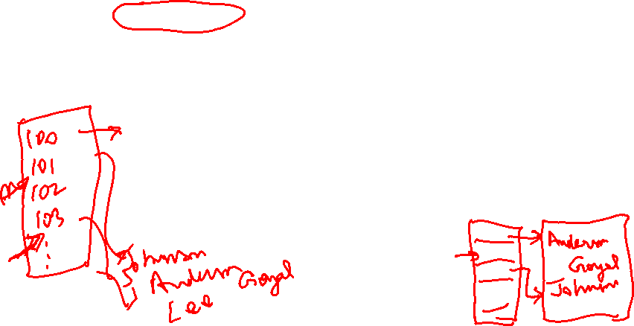
Index Update: Insertion
Single-level index insertion:
Perform a lookup using the search-key value appearing in the record to be inserted.
Dense indices – if the search-key value does not appear in the index, insert it.
Sparse indices – if index stores an entry for each block of the file, no change needs to be made to the index unless a new block is created.
If a new block is created, the first search-key value appearing in the new block is inserted into the index.
Multilevel insertion and deletion: algorithms are simple extensions of the single-level algorithms

Slide 24

Multiple-Key Access
Use multiple indices for certain types of queries.
Example:
select ID
from instructor
where dept_name = “Finance” and salary = 80000
Possible strategies for processing query using indices on single attributes:
1. Use index on dept_name to find instructors with department name Finance; test salary = 80000
2. Use index on salary to find instructors with a salary of $80000; test dept_name = “Finance”.
3. Use dept_name index to find pointers to all records pertaining to the “Finance” department. Similarly use index on salary. Take intersection of both sets of pointers obtained.

Slide 25
Indices on Multiple Attributes
Suppose we have an index on combined search-key
(dept_name, salary).
With the where clause where dept_name = “Finance” and salary = 80000 the index on (dept_name, salary) can be used to fetch only records that satisfy both conditions.
Using separate indices is less efficient — we may fetch many records (or pointers) that satisfy only one of the conditions.
Can also efficiently handle where dept_name = “Finance” and salary < 80000
But cannot efficiently handle where dept_name < “Finance” and balance = 80000
May fetch many records that satisfy the first but not the second condition

Slide 26

B⁺-Tree Index Files
B⁺-tree indices are an alternative to indexed-sequential files.
Disadvantage of indexed-sequential files
performance degrades as file grows, since many overflow blocks get created.
Periodic reorganization of entire file is required.
Advantage of B⁺-tree index files:
automatically reorganizes itself with small, local, changes, in the face of insertions and deletions.
Reorganization of entire file is not required to maintain performance.
(Minor) disadvantage of B⁺-trees:
extra insertion and deletion overhead, space overhead.
Advantages of B⁺-trees outweigh disadvantages
B⁺-trees are used extensively

Slide 27
B⁺-Tree Index Files (Cont.)
A B⁺-tree is a rooted tree satisfying the following properties:
All paths from root to leaf are of the same length
Each node that is not a root or a leaf has between ⎡n/2⎤ and n children.
A leaf node has between ⎡(n–1)/2⎤ and n–1 values
Special cases:
If the root is not a leaf, it has at least 2 children.
If the root is a leaf (that is, there are no other nodes in the tree), it can have between 0 and (n–1) values.

Slide 28
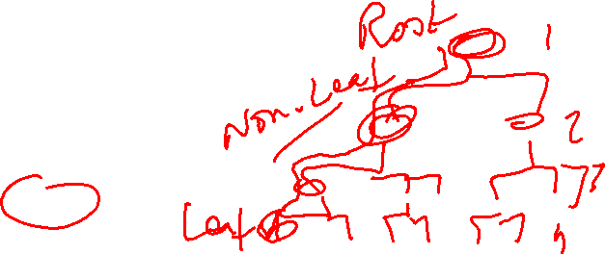
Example on B+
A file with 1,000,000 records
B+ tree node size = 100
Number of levels in B+ tree: log ₅₀ 1,000,000 = 4
At most 4 I/Os are needed in order to access any record in the file
For more understanding, watch video at:
https://www.youtube.com/watch?v=2AD13EPQAms

Slide 29
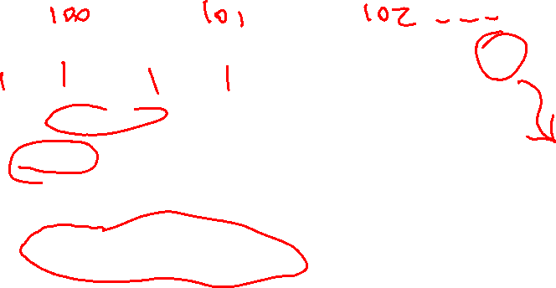
B⁺-Tree Node Structure
Typical node
K_{i} are the search-key values
P_{i} are pointers to children (for non-leaf nodes) or pointers to records or buckets of records (for leaf nodes).
The search-keys in a node are ordered
K₁ < K₂ < K₃ < . . . < K_{n–1}
(Initially assume no duplicate keys, address duplicates later)

Slide 30

Non-Leaf Nodes in B⁺-Trees
Non leaf nodes form a multi-level sparse index on the leaf nodes. For a non-leaf node with m pointers:
All the search-keys in the subtree to which P₁ points are less than K₁
For 2 ≤ i ≤ n – 1, all the search-keys in the subtree to which P_{i} points have values greater than or equal to K_{i–1} and less than K_{i}
All the search-keys in the subtree to which P_{n} points have values greater than or equal to K_{n–1}

Slide 31
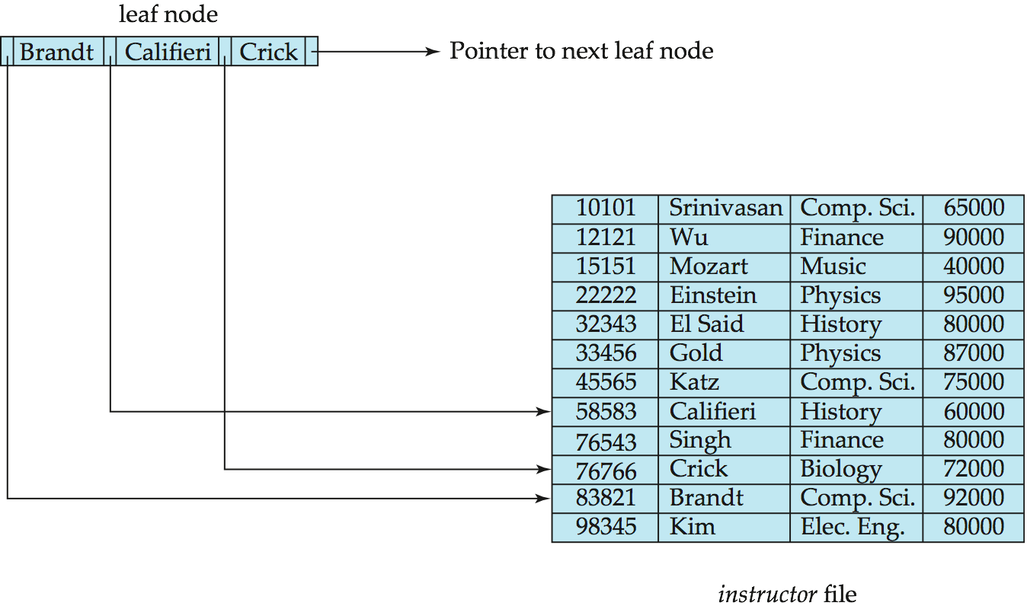
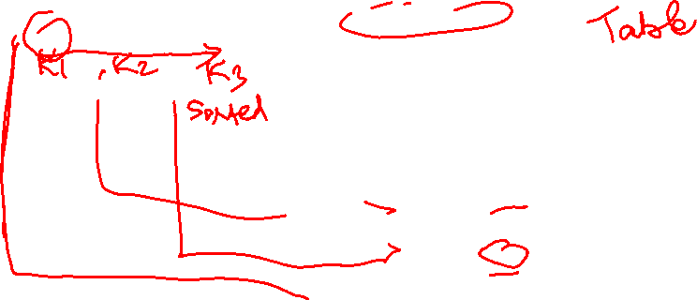
Leaf Nodes in B⁺-Trees
Properties of a leaf node:
For i = 1, 2, . . ., n–1, pointer P_{i} points to a file record with search-key value K_{i},
If L_{i}, L_{j} are leaf nodes and i < j, L_{i}’s search-key values are less than or equal to L_{j}’s search-key values
P_{n} points to next leaf node in search-key order

Slide 32
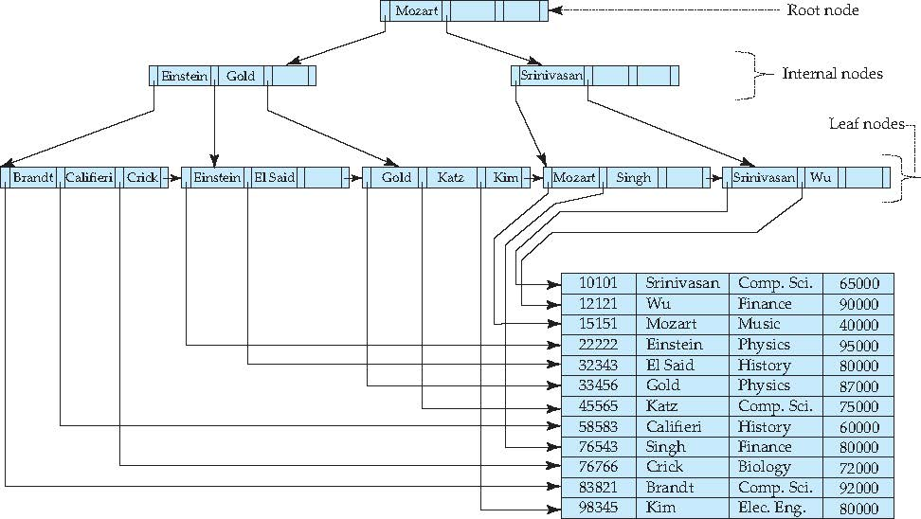

Example of B⁺-Tree

Slide 33
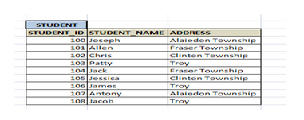
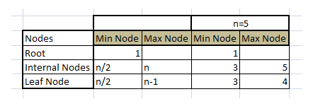
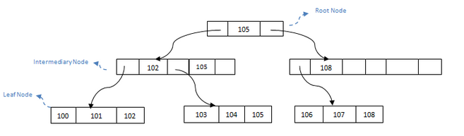
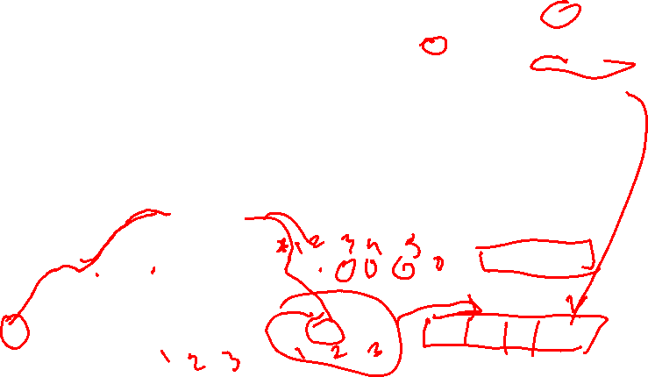
B⁺-Tree Index Files
B+ tree has one root, any number of intermediary nodes (usually one)
and a leaf node. Consider the STUDENT table below.

Slide 34
B⁺-Tree Index Files
The main goal of B+ tree is:
Sorted Intermediary and leaf nodes: Since it is a balanced tree, all nodes should be sorted.
Fast traversal and Quick Search:
B+ tree allows all the intermediary and leaf nodes to be partially filled – it will have some percentage defined while designing a B+ tree.
This percentage up to which nodes are filled is called fill factor.
If a node reaches the fill factor limit, then it is called overflow page
If a node is too empty then it is called underflow
In our example above, intermediary node with 108 is underflow. And leaf nodes are not partially filled, hence it is an overflow. In ideal B+ tree, it should not have overflow or underflow except root node

Slide 35
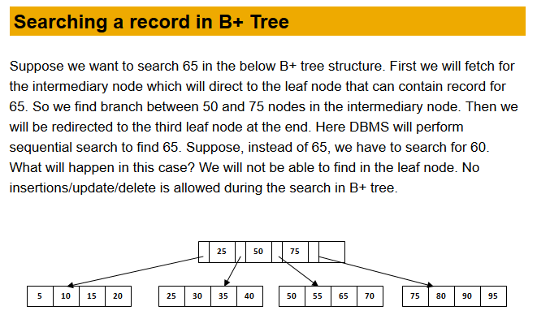

B⁺-Tree Index Files

Slide 36
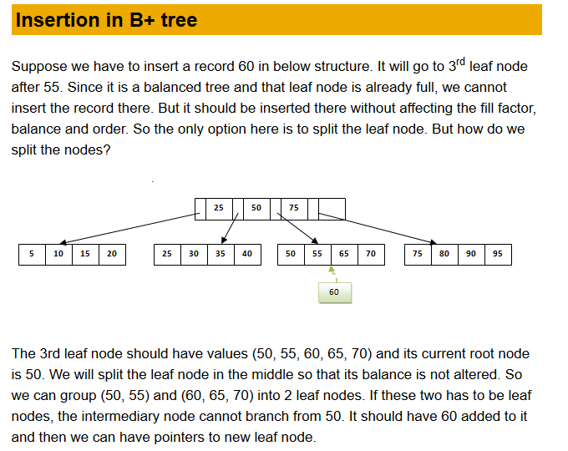

B⁺-Tree Index Files

Slide 37
B⁺-Tree Index Files

Slide 38
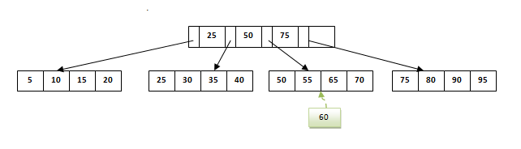
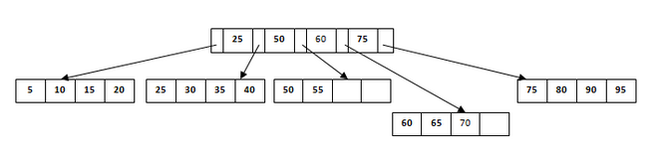
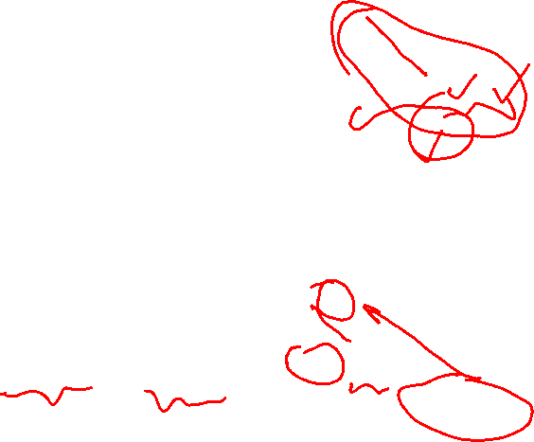
B⁺-Tree Index Files
This is how we insert a new entry when there is overflow. In normal scenario, it is simple to find the node where it fits and place it in that leaf node

Slide 39

Hash based Indexing
Good for equality selections. E.g. where salary = 90000
A bucket is a unit of storage containing one or more records (a bucket is typically a disk block).
In a hash file organization we obtain the bucket of a record directly from its search-key value using a hash function.
Hash function h is a function from the set of all search-key values K to the set of all bucket addresses B.
Records with different search-key values may be mapped to the same bucket; thus entire bucket has to be searched sequentially to locate a record.
No need for “index entries” in this scheme.

Slide 40
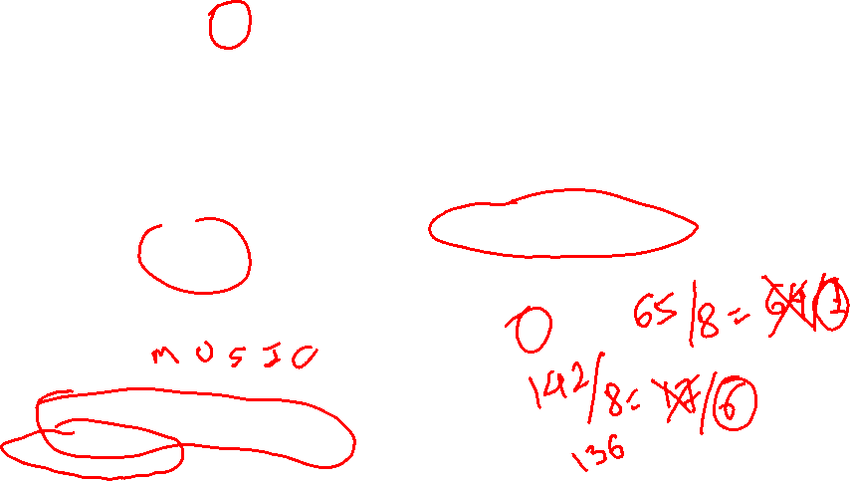
Example of Hash File Organization
Hash file organization of instructor file, using dept_name as key:
Assume there are 8 buckets,
The binary representation of the ith character is assumed to be the integer i.
The hash function returns the sum of the binary representations of the characters modulo 8
h(music) = (13+21+19+9+3) mod 8 = 65 mod 8 = 1
h(Music) = 1 h(History) = 2 h(Physics) = 3 h(Elec. Eng.) = 3

Slide 41
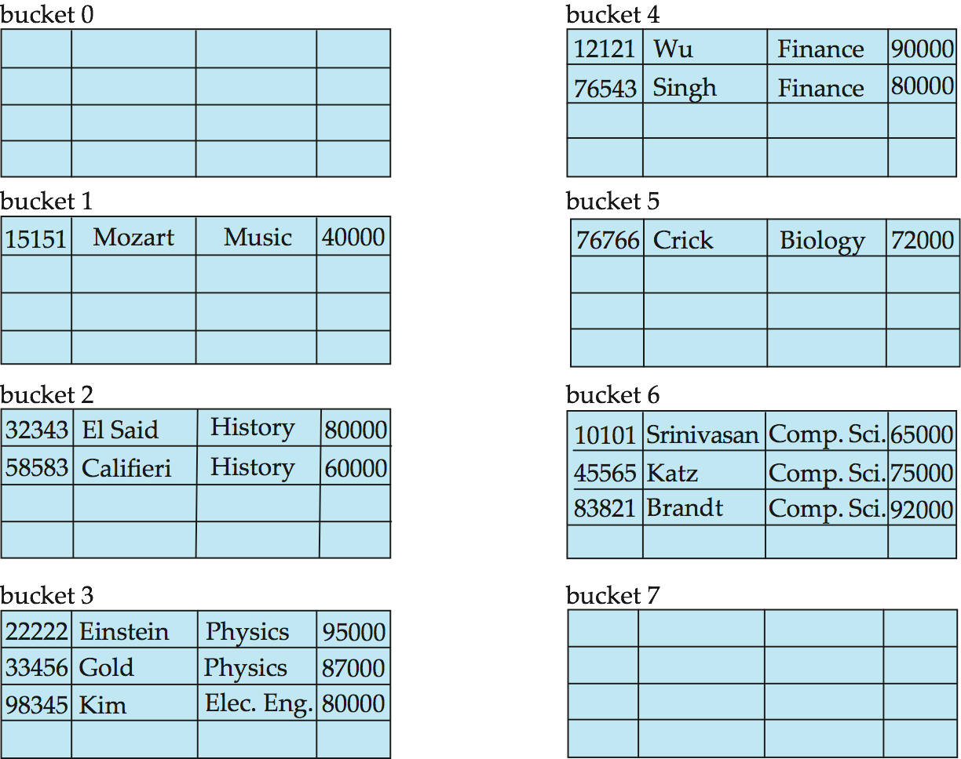

Hash File Organization Example
Hash file organization of instructor file, using dept_name as key

Slide 42
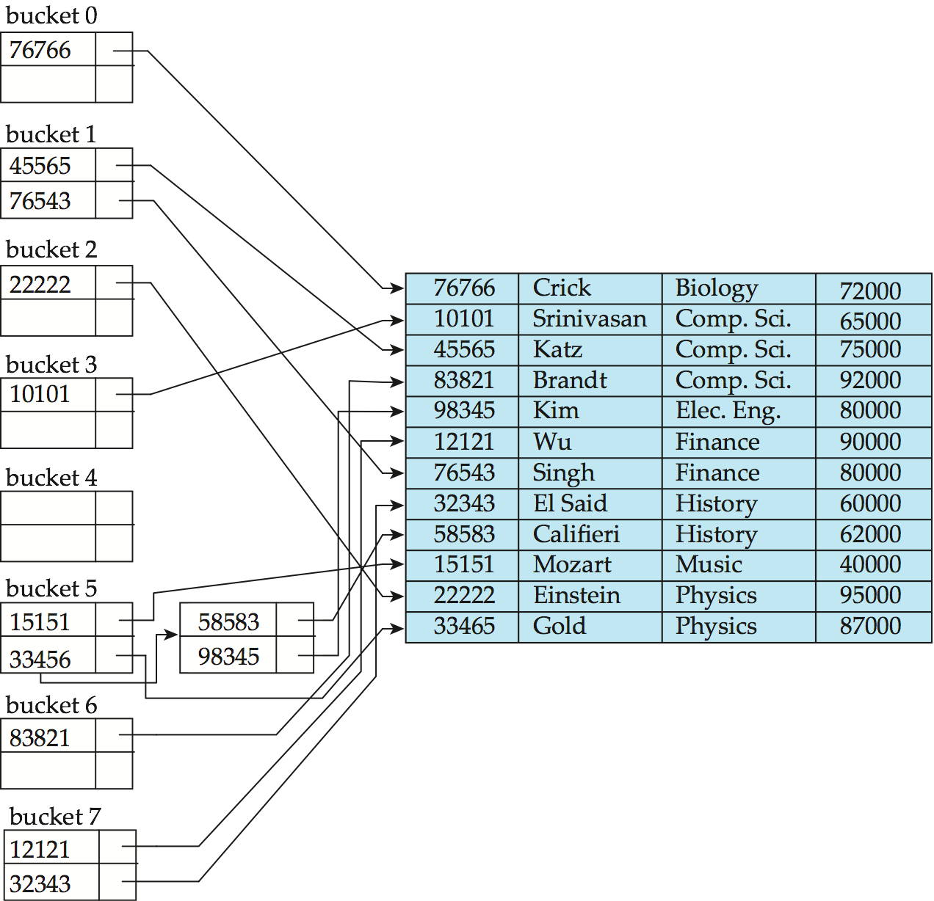

Hash Index Example
hash index on instructor, on attribute ID
h(76766) = (7+6+7+6+6) mod 8 = 0
h(45565) = (4+5+5+6+5) mod 8 = 1
h(33454) - ?

Slide 43
Comparison between Indices
Cost of periodic re-organization
Relative frequency of insertions and deletions
Is it desirable to optimize average access time at the expense of worst-case access time?
Expected type of queries:
Hashing is generally better for equality search
B+ trees (ordered indexes) are better for range queries

Slide 44
Understanding the Workload
For each query in the workload:
Which relations does it access?
Which attributes are retrieved?
Which attributes are involved in selection/join conditions? How selective are these conditions likely to be?
For each update in the workload:
Which attributes are involved in selection/join conditions? How selective are these conditions likely to be?
The type of update (INSERT/DELETE/UPDATE), and the attributes that are affected.
Updates to the database causes updates to indexes as well
Notes:
11

Slide 45
Choice of Indexes
What indexes should we create?
Which relations should have indexes?
What field(s) should be the search key?
Should we build several indexes?
For each index, what kind of an index should it be?
Clustered? Hash/B+ tree?
Notes:
12

Slide 46
Choice of Indexes (continued)
One approach: Consider the most important queries.
Consider the best plan using the current indexes, and see if a better plan is possible with an additional index. If so, create it.
Obviously, this implies that we must understand how a DBMS evaluates queries and creates query evaluation plans!
For now, we discuss simple 1-table queries.
Before creating an index, must also consider the impact on updates in the workload!
Trade-off: Indexes can make queries go faster, updates slower. Require disk space, too.
Consider use of SELECT vs UPDATE
Notes:
13

Slide 47
Index Selection Guidelines
Attributes in WHERE clause are candidates for index keys.
Equality conditions suggests hash index.
Range query suggests tree index.
Clustering is especially useful for range queries; can also help on equality queries if there are many duplicates.
Notes:
14

Slide 48
Index Selection Guidelines (continued)
Multi-attribute search keys should be considered when a WHERE clause contains several conditions.
Order of attributes is important for range queries.
Such indexes can sometimes enable index-only strategies for important queries.
For index-only strategies, clustering is not important!
Try to choose indexes that benefit as many queries as possible. Since only one index can be clustered per relation, choose it based on important queries that would benefit the most from clustering.
Notes:
14

Slide 49
Examples of Indexes
B+ tree index on E.age can be used to get qualifying tuples.
How selective is the condition?
Is the index clustered?
Consider the GROUP BY query.
If many tuples have E.age > 10, using E.age index
and sorting the retrieved tuples may be costly.
Clustered E.dno index may be better!
Equality queries and duplicates:
Clustering on E.hobby helps!
SELECT E.dno
FROM Emp E
WHERE E.age>40
SELECT E.dno, COUNT (*)
FROM Emp E
WHERE E.age>10
GROUP BY E.dno
SELECT E.dno
FROM Emp E
WHERE E.hobby=Stamps
Notes:
18

Slide 50

Indexes with Composite Search Keys
To retrieve Emp records with age=30 AND sal=4000, an index on <age,sal> would be better than an index on age only or an index on sal only
If condition is: 20<age<30 AND 3000<sal<5000:
Clustered tree index on <age,sal> or <sal,age> is best.
If condition is: age=30 AND 3000<sal<5000:
Clustered <age,sal> tree index much better than <sal,age> index!
Composite indexes are larger, updated more often.
Notes:
20

Slide 51
Summary
An index is a collection of data entries plus a way to quickly find entries with given key values.
We can have several indexes on a given file of data records, each with a different search key.
Indexes can be classified as clustered vs. unclustered. Differences have important consequences for utility/performance.
Notes:
15

Slide 52
Index Definition in SQL
Create an index
create index <index-name> on <relation-name> (<attribute-list>)
E.g.:
create index indexname on branch(branch_name);
Create index dept_idx on department(dept_name);
Use create unique index to indirectly specify and enforce the condition that the search key is a candidate key.
Not really required if SQL unique integrity constraint is supported
To drop an index
drop index <index-name> on <relation-name>
Most database systems allow specification of type of index, and clustering.

Slide 53

CREATE INDEX Syntax
CREATE [UNIQUE|FULLTEXT|SPATIAL] INDEX index_name
[index_type]
ON tbl_name (index_col_name,...)
[index_option]
[algorithm_option | lock_option] ...
index_col_name:
col_name [(length)] [ASC | DESC]
index_option:
KEY_BLOCK_SIZE [=] value
| index_type
| WITH PARSER parser_name
| COMMENT 'string'
index_type:
USING {BTREE | HASH}
algorithm_option:
ALGORITHM [=] {DEFAULT|INPLACE|COPY}
lock_option:
LOCK [=] {DEFAULT|NONE|SHARED|EXCLUSIVE}

Slide 54

Reading and Assignment
No. | Date | Topics and Required Reading | Assignments
 |  |  |  | start of class day

